Slide 1



Quality Improvement Plan (QIP) Journey Web Series: Chapter 3
Measurement Session Two –
Data Collection; fingers and toes are not enough
November 13, 2020

Slide 2
Using Zoom Together!
Audio and Visual Controls
Notes:
2

Slide 3
Using Zoom Together!
During the session if you want to contribute but not speak please use the chat function at the right hand of the toolbar
Notes:
3

Slide 4
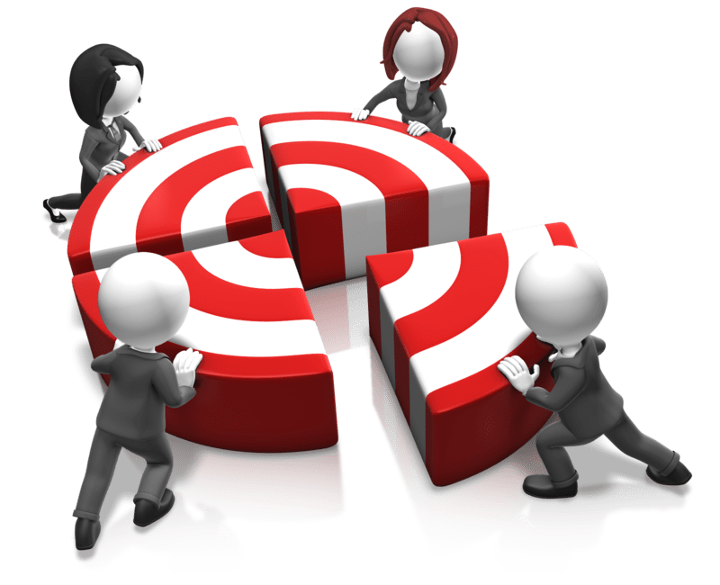
Learning Objectives
Through active participation in this session participants will:
Know how to create a measurement plan
Understand how to complete measurement operational definitions – numerator and denominator, targets
Know how to record measures on the QIP template
Understand how to graphically display and interpret data
Know the pitfalls around data collection and analysis
Discuss keys to success
Notes:
Open mind, receptive to others ideas, People have an understanding between QI QA QIPs and accreditation and how can work together learn what QI isn’t
Ask Q – In which region of Ontario are you located? Please use the chat box to enter your Ontario Health region (North, East, West, Central or Toronto).

Slide 5
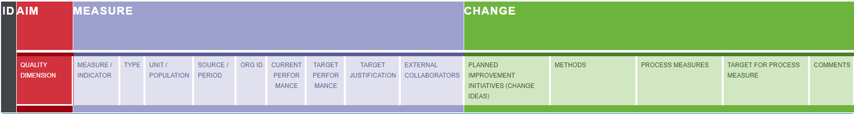
Quality Improvement is a priority
Strategic Plan
Quality Plan (QIP)
Accreditation
Ministry of Health
  Improving quality
  Implementing innovative solutions
Centre of Excellence for MH&A
  Performance indicators to establish & monitor performance expectations
Ontario Health
  Mandate to “bring together a unified “single team” to “execute the government’s strategy, oversee health care delivery, improve clinical guidance, and extend and strengthen quality and performance improvement capacities across the continuum of care.”
Source: Ontario Ministry of Health Roadmap to Wellness
Notes:
5

Slide 6
Our two roles in health care
All health care professionals have 2 jobs at work
Providing care; and
Improving care
Quality by Design – A Clinical Microsystems Approach
E.C. Nelson, P.B. Batalden, M.M. Godfrey

Slide 7
Chapter One: Once Upon a Time There was a QIP Journey
Chapter Two: Counting What Counts
Recap
Start with what you know; look for what stands out
Use the quality domains (safe, effective, person centered, efficient, timely, equitable) and your Strategic Directions and Operational Goals to guide you through the process
Use others, you are not alone:
  In analyzing the data, it may or may not be an area for improvement, help to narrow it down
  Your board and leadership team to set priorities for the QIP
  To develop your teams
Use data for decision making: look at all the available data – what are your sources?, check out the complaints and compliments
Remember everything that counts can’t be counted – look at qualitative data
Notes:
Deb to work on recap from chapt 1 & 2

Slide 8



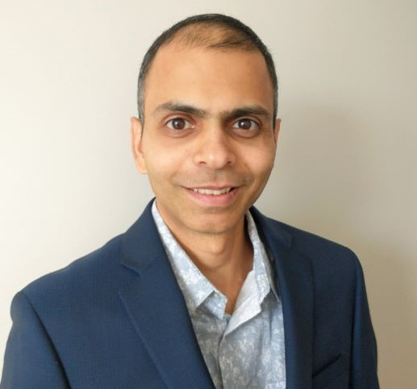
Introducing today’s Panelists
Alice Strachan
Quality Specialist
Ontario Health
Debbie Bang
Director QI AMHO, co-lead
E-QIP
Hrishikesh Navare
QI/Data Coach E-QIP
Naushaba Degani
Director QI
CMHA Ont, co-lead E-QIP
Notes:
8

Slide 9

Start with what you already know!
What do you already collect?
Ontario Perception Of Care (OPOC)
Employee Engagement/Satisfaction
MIS / Common Data Set (CDS) i.e. wait times, contacts
Client Record, OCAN– other data, what reports can you access
Health and Safety i.e. incidents reported, evacuation drills
HR – sick time, turn over, training
Other
Don’t listen very much to our users, & we do the designing
Listen to our users, then go off to do the designing
Listen to our users, & then go off with them to do the designing
Notes:
Don’t reinvent the wheel, use the data that you have – rename?
9

Slide 10
Measurement Plan
The data must be important to your team
Helps you to determine if improvement is occurring
Make sure your measures relate directly to the area you are changing
Consider using a measurement dashboard to help you to keep track of your measures and to plan your data collection. An updated dashboard is a helpful tool when reporting your QI project progress to your Executive Sponsor, team members and staff!
http://www.kingsfund.org.uk/projects/pfcc/measuring-improvement

Slide 11
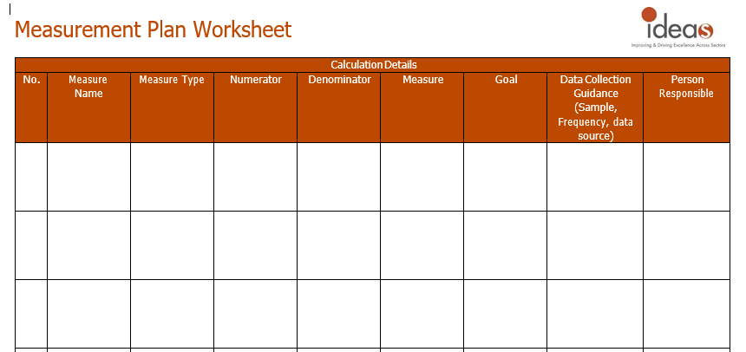
Measurement Plan
What do you already measure?
Don’t listen very much to our users, & we do the designing
Listen to our users, then go off to do the designing
Listen to our users, & then go off with them to do the designing
Adapted from HQO, Quality Improvement Plan template and http://www.kingsfund.org.uk/projects/pfcc/measuring-improvement
Notes:
11

Slide 12
Family of Measures
Outcomes Measures
Process Measures
Balancing Measures
  Where are we ultimately trying to go?
  Are your changes leading to improvement
  Measures of the client or customer
  Typically represents “the client voice”
  Are we doing the right things to get to the outcome?
  Measures of the workings of the system
  Are we doing the right steps – are our changes working?
  Are the changes we are making to one part of the system causing unexpected changes in other parts of the system? (i.e. increased workload for staff?)
  Measures of other parts of the system

Slide 13
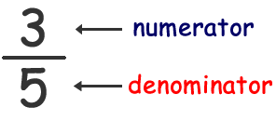
Operational Definitions
Numerator – the number above the line in a fraction
  represents how many equal parts of the whole are being considered or added together
  the numerator of the fraction 3/5 is 3
Denominator – the number below the line in a fraction
  represents the total number of parts created from the whole.
  The denominator of the fraction 3/5 is 5
https://www.youtube.com/watch?v=j7WhRMvlQwo
Play till 1:47
OPOC # 27 Staff helped me develop a plan for when I finish the program/treatment
Total completed OPOCs A/19-M/20 = 253
Strong Agree/Agree = 173
173 numerator
253 denominator = 68.4%

Slide 14

If I asked you to count the number of people who walk into a room what questions would you have for me?
Notes:
Use chat box

Slide 15
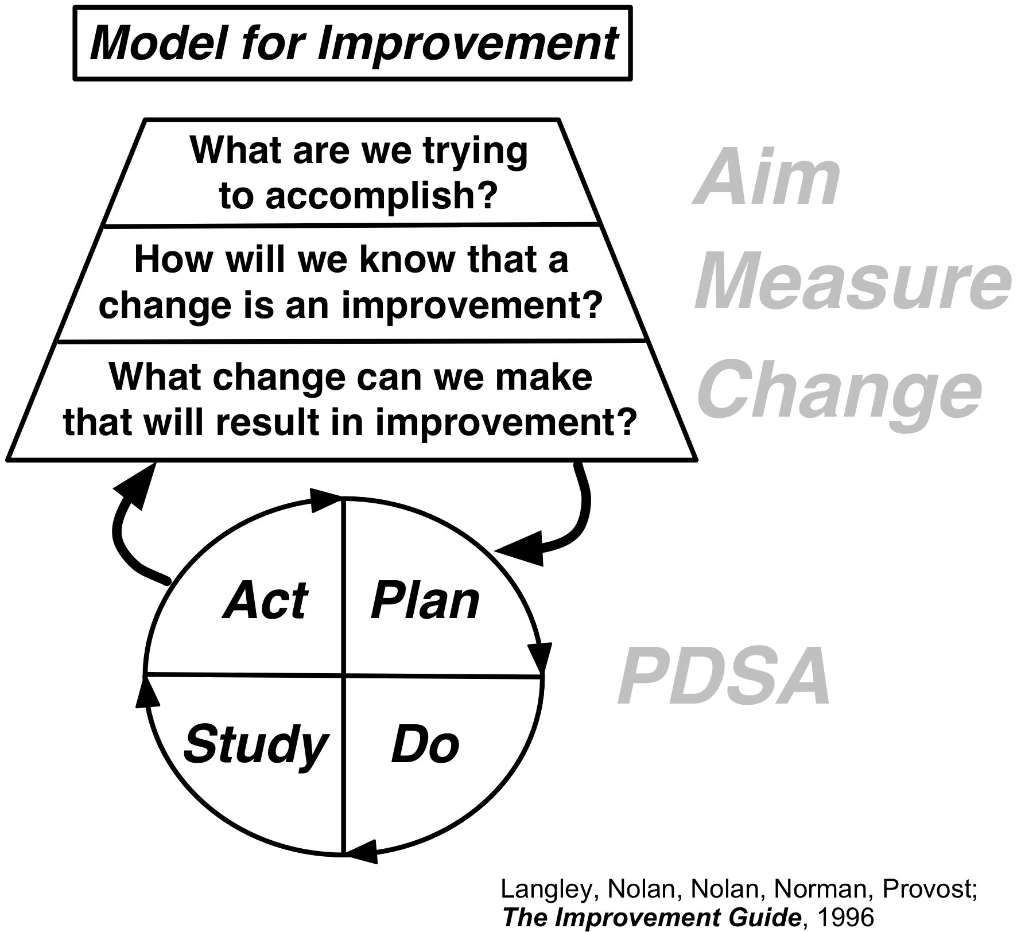
“How will we know that a change is an improvement?”
Charter Measures (Big Dots)
Data collected to determine success of change being tested (Little Dots)

Slide 16

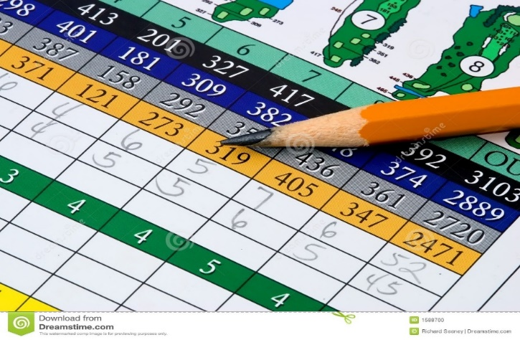
Why is measurement important?
Real-time measures are essential for QI
Confirm if perception is in fact reality
Collecting and displaying the measures is an engagement strategy
Notes:
So for all of you who play golf, you already understand the importance of measurement – cause you are out there playing your game and recording your score at each step, you are getting real time feedback on your performance. You want to try something different, say use a 3 iron instead of the 5 wood, go ahead and test it – at the end of the round, your score will give you a glimpse if the change made a difference. If you are feeling like the back nine is not going well, your cumulative score at the end of the course will provide precise feedback on your performance. You can conclude based on historical comparisons if you improved or remained consistent. And is their nothing better than stimulating conversation afterwards with your foursome about the performance than reviewing each other’s scorecard. By measuring how well you play in golf, you have an idea if things are getting better, you are learning about your system (are your irons better than your woods), and monitoring your progress to your set aim of being a scratch golfer.

Slide 17
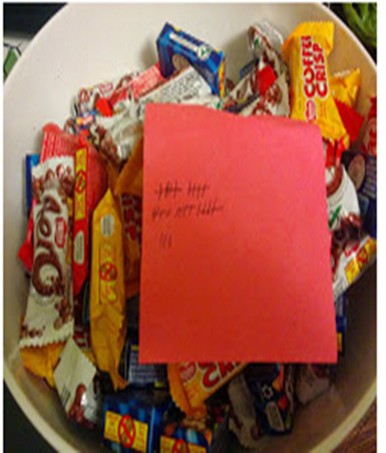
Make it easy to be successful

Slide 18
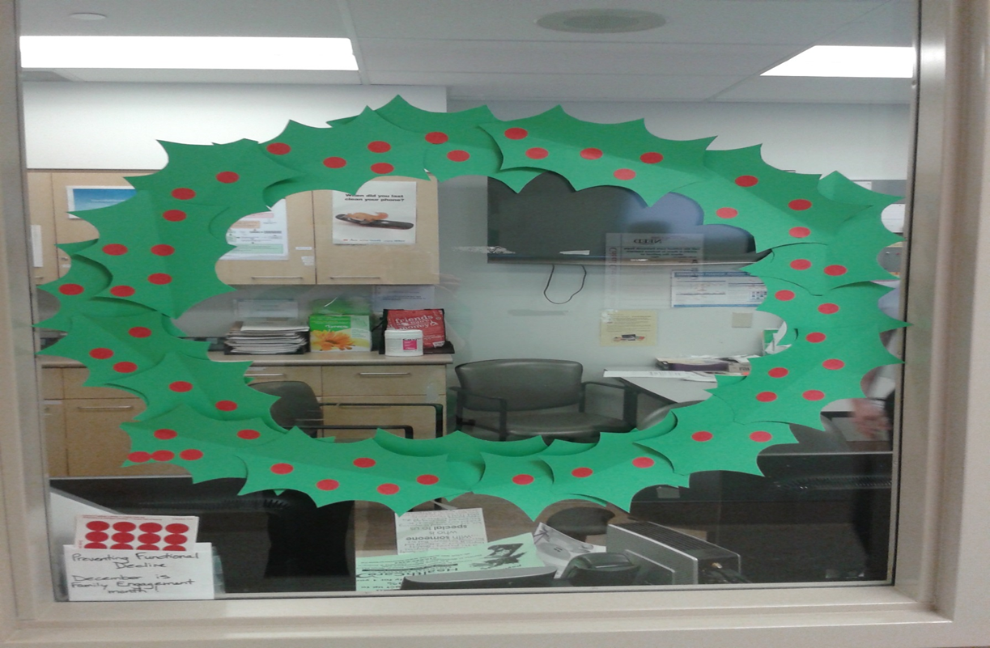
Make it fun

Slide 19
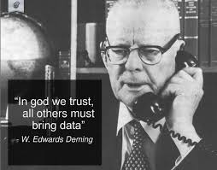

Slide 20
Linking to the AIM
Use key measures to assess progress towards your AIM
Use specific measures for learning during PDSA cycles
Use balancing measures to assess whether the system as a whole is being improved.
Use data to focus improvement and refine changes.
balancing
process
outcome
Change idea tested
Project
“big dot”
System

Slide 21
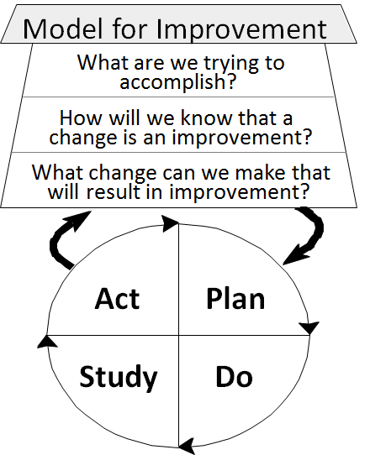
How Measures Align with QIP
What are we trying to accomplish?
How will we know that a change is an improvement?
What change can we make that will result in improvement?
Notes:
Lessons from the expert - Alice

Slide 22

In QI Data is for Light not Heat
Notes:
The purpose of measuring is in QI is for learning, not for judgment or comparison.

Slide 23
Progress Report (starts in your second QIP submission)

Slide 24

Target Setting

Slide 25
Why do we need a target for Improvement?
When you are planning to improve performance in an area it is important to have information on:
  Your current performance – baseline
  What direction is an improvement?
  What would reflect high quality care (aspirational) balanced with what can be done (achievable)

Slide 26
What are benchmarks?
Identification of a realistic, achievable, ‘best in class’ performance. It is of utmost importance that benchmarks represent a realistic, achievable goal to achieve provider acceptance
Achievable Benchmarks of Care, CI Kiefe et al, 1998
For benchmarks to successfully move performance, they must be:
Achievable: benchmark levels should be attainable; i.e. clinically realistic
Agreeable to major stakeholders
Reflective of top performance all providers who are high performers contribute to the setting of the benchmarks and providers with small numbers of patients/residents do not unduly affect the benchmark
Notes:
Definitions are from Webster dictionary
From Identifying Achievable benchmarks f Care: Concepts and Methodology, CI Kiefe et al, 1998.
Benchmarks are markers of excellence to which organizations can aspire
To help guide providers, benchmarks should be:
Evidence-based/data-driven
Agreeable to major stakeholders
A catalyst for quality improvement
An indication of high quality of care
Absolute values: For example, if a benchmark for an indicator were set to 5% and a home’s indicator performance meets or exceeds this value, then this suggests that the home is providing high quality care for that particular indicator.
For example, although setting a relative % decrease from baseline can be considered a target or goal, it is not a benchmark
A benchmark is a single value. A benchmark is not a relative change.
Targets can be identified using a few different approaches:
Benchmark
Provincial Average
Peer Performance
Literature, evidence based (standards)
Planned change in performance using an absolute or relative value as the guide

Slide 27
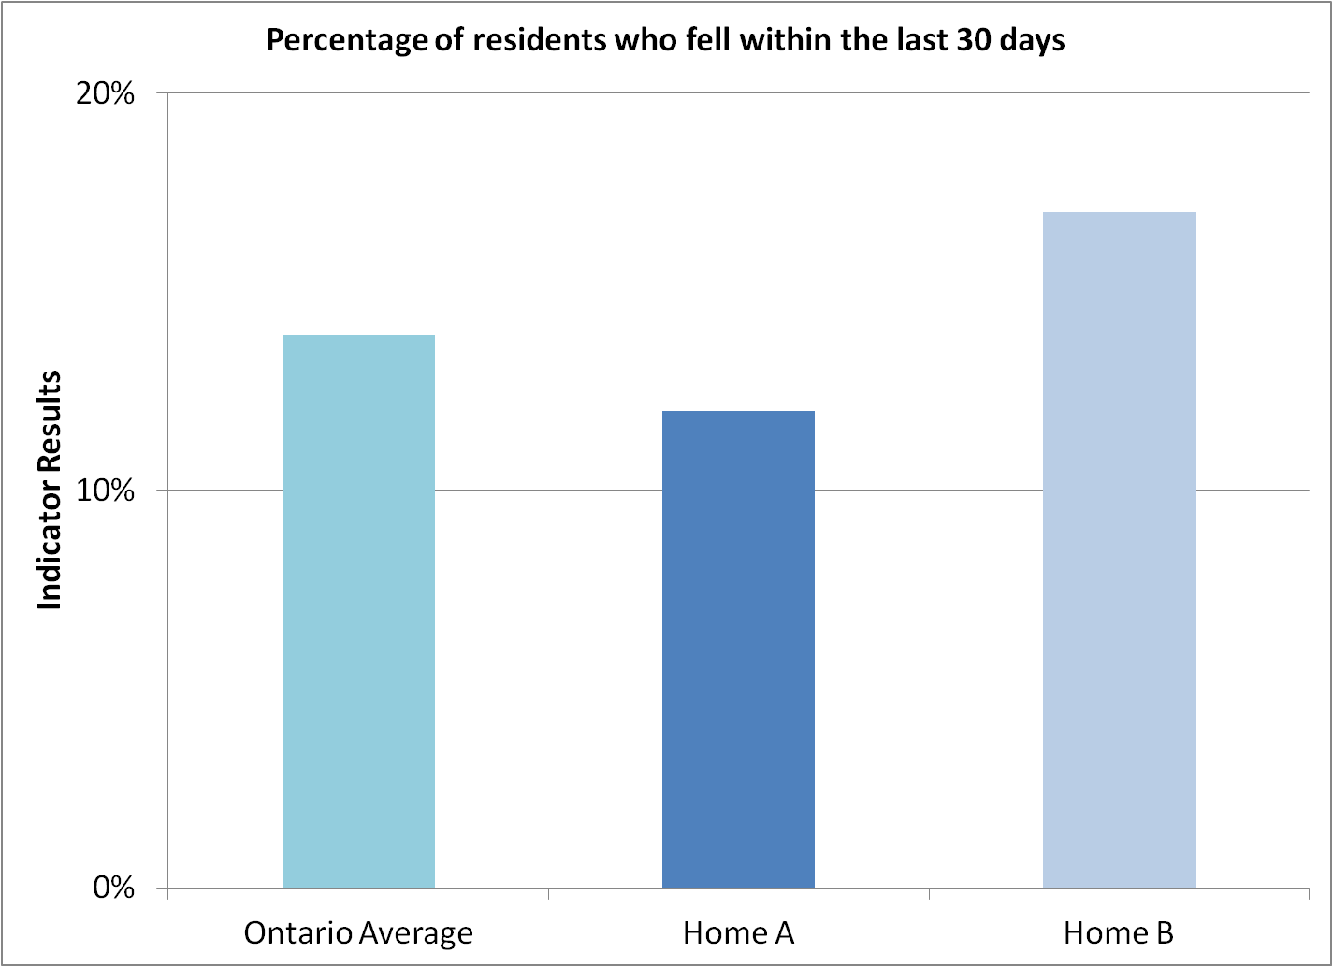
Using Targets or Provincial Comparators
Providers can compare results with the target or the provincial performance value (note: for this indicator, lower indicates better performance)
Home B is performing worse than the provincial average and so can use this value as a target.
But Home A is doing better than the provincial average. What can they use?
If a benchmark exists, Home A can use the benchmark to set their target for performance
Target = 9%

Slide 28
Setting Targets using Provincial Comparisons and Peer Performance data
Notes:
When there is no benchmark or provincial value, it is helpful to have a value that represents peer performance.
Here you can see that three agencies fall below the summed performance of peers – these agencies could use the peer performance value (85.04%) as their target.
But what about the others?

Slide 29
Identifying Targets
When you don’t have information on peer performance, you can set a target performance based on a change in absolute performance or based on relative improvement.
For example, if you are agency C (performance = 89.8%), you may want to increase your performance
  by an absolute value of 5% from 89.8% to 94.8%
  By a relative value of 3% (3% of 89.8%). This would equal an absolute increase of 2.7% and a target of 92.5%

Slide 30

Variation
Variation is all around us and is a natural part of any system (e.g. time it takes to get to work, weight, time from referral to first appointment, stock market?)
Measurement of any process or outcome for different people or at different times will not show the same value.
If you saw a report, and every value would be the same, would you be surprised?
There is variation in processes and outcomes
Some variation is expected and other variation is not
A basic principle of Quality Improvement is to reduce the amount of variation in a system!
Source: Murray, M (2006). Variation and Control Charts

Slide 31
Understanding Variation
Common cause
affects everyone, over all outcomes and over time
normal ebb and flow of a process or system
time it takes to travel to work using public transit
wait times
crisis calls
clinical values (BP, weight, blood sugar etc.)
Special cause
arises because of specific circumstances and does not affect everyone or all parts of the system all the time
when something happens that wasn’t expected (positive or negative)
if there is a problem with the transit, school holiday, or there is a road closure- could impact (slow down or speed up) the time it takes to get to work
demand for service
clinical values (unusual blood value)
OPOC Scores
Impact of COVID**
on client perception of care
http://www.qihub.scot.nhs.uk/media/1069384/sis%20day%201%20facilitator%20notes.pdf

Slide 32
What’s Wrong with Descriptive Statistics?
HC Data Guide, p 111

Slide 33
Scatter Plots for Data in Table 4-1
HC Data Guide, p. 112

Slide 34
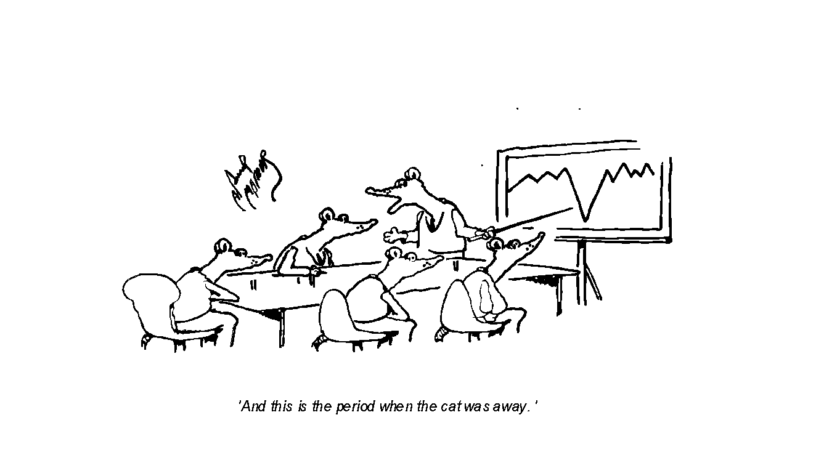
Understanding Variation with Run Charts
‘And this is the period when the cat was away.’
Notes:
A run chart can help us to understand more about when something happened and what it may have been the result of – it fills in the gaps and helps us to visually see whether or not we are getting the results we want – is our theory correct or incorrect?
We want to understand more about variation in order to improve our processes

Slide 35
Run Chart – An Overview
What Is It?
A run chart is a graphical display of data plotted in chronological order
It is very easy to develop and simple to interpret
Its simplicity makes it a powerful tool and one of the most useful for understanding and communicating variation
When/Why Would I Use It?
To help us understand baseline performance and identify opportunities for improvement
To determine if a change resulted in improvement
To determine if we are holding the gains made by our improvement
To determine readiness for spread

Slide 36
Understanding Run Charts
Useful tool to understand data “at a glance.”
Determine the following information just by eye balling the run chart:
Are we observing common cause or special cause variation?
Is there evidence of improvement?
Is the data collection or any unexpected thing influence the run chart?
Anyone can quickly grasp your “data story”
We can see changes over time – which is crucial to knowing if we are making improvements!

Slide 37
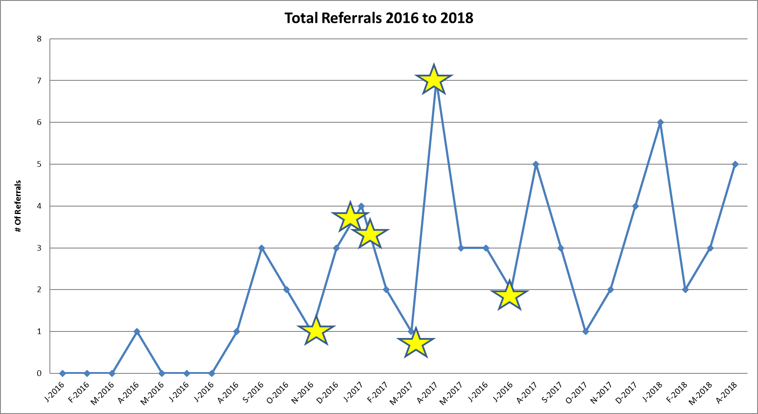
Example from Cohort 1 of E-QIP
Change ideas:
Dec. 19, 2016: Initial contact with first hospital
Jan. 17, 2017: meeting with first hospital ER director
Jan. 31, 2017: Participated in huddles with first hospital teams
March 16, 2017: Letters to four other community hospitals
April 25, 2017: Meeting with ER director at second hospital
Jul 28, 2017: Participated in huddles at second hospital
Nov 24, 2017: Follow up letters and visit to ER director at third hospital
Dec. 8, 2017: Phone call with third hospital ER director
Jan 27, 2018: Lunch session with ER Director of third hospital
Notes:
Key messages:
Run charts are similar to the other tools in that the conversations that happen from them are the meaningful part. It allows people to talk about the meaning behind changes and what they will do next.
Talk about how run charts can be used to monitor performance, but, can also be used at the outset of a project to diagnoses problems. Problems and aims should be based in data – run charts can eb a way for us to identify when a problem may have occurred and to investigate that problem or point in time further – OR they can let us monitoring changes before and after an intervention – or both. This is a good time to nots that all tools can be used differently, depending on the projects. They can be used outside of a formal QI process and still be useful for brain storming or understanding issues better.

Slide 38

Value of a Run Chart
Remember the value of the run chart is that discussion that you and your team have about what the data is telling you.
It is the story behind the data that helps us to determine whether or not our theory/hunch was correct.
Notes:
These can be diagnostic or monitoring/performance tools
Once you figure out the problem and probably causes, you can dig deeper and track these causes.
You can also use run charts to measure the difference of a certain outcome before and after an intervention to try to correct the issue and see the difference pre/post intervention.
There are many different purposes for tools – and they can either all be used together or can be used on their own.
Key messages:
Run charts are similar to the other tools in that the conversations that happen from them are the meaningful part. It allows people to talk about the meaning behind changes and what they will do next.
Talk about how run charts can be used to monitor performance, but, can also be used at the outset of a project to diagnoses problems. Problems and aims should be based in data – run charts can eb a way for us to identify when a problem may have occurred and to investigate that problem or point in time further – OR they can let us monitoring changes before and after an intervention – or both. This is a good time to nots that all tools can be used differently, depending on the projects. They can be used outside of a formal QI process and still be useful for brain storming or understanding issues better.

Slide 39

Poll
We are thinking about adding a separate webinar on Run charts to this series?
Would this be of interest to you?
Yes
No
Not at this time

Slide 40
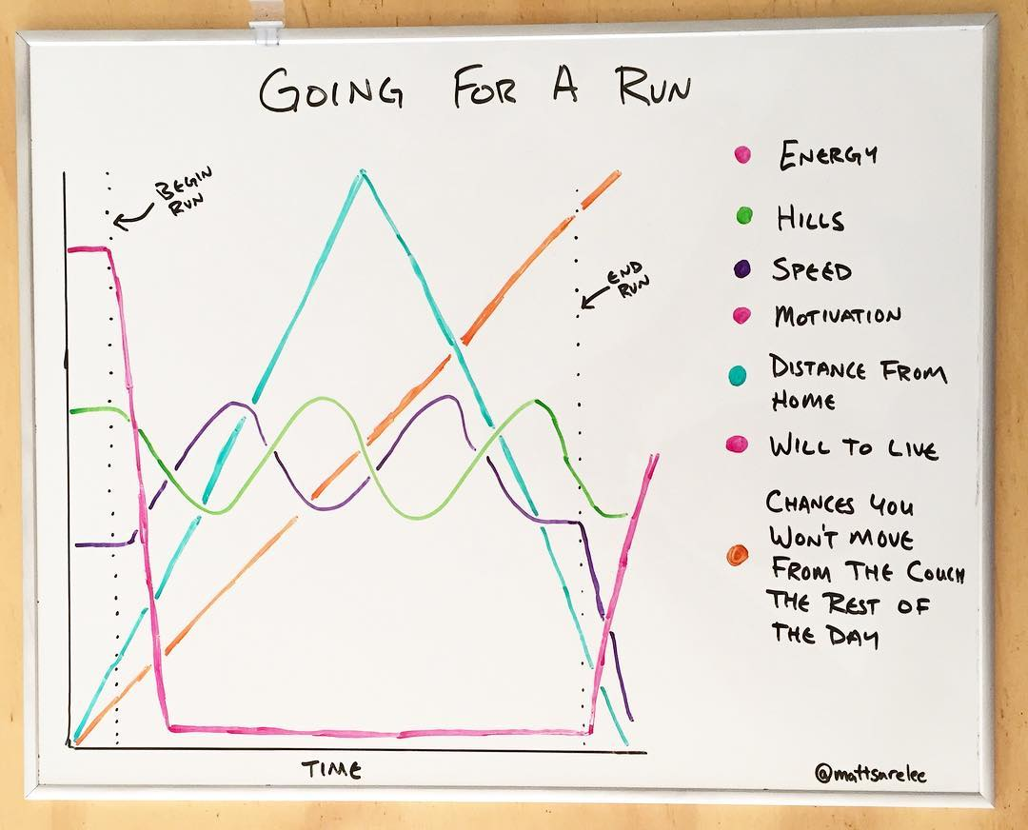
Pitfalls around Data Collection
Incomplete, missing/inappropriate data
Challenges with preparing data reports – lack of expertise, delays, not quite the right information, challenging to decipher
Risk of getting way laid by a single point in time (outliers) – consider normal variation over time
Missed opportunity to dig deeper, question the data source, investigate, further discussion with clients (focus groups etc)
Reacting to something that looks like a change in the data based on one point
Data collection methods that are labour/time intensive
Collecting data that is IBU – interesting but useless

Slide 41
Keys to Success When Getting Started
Be curious
Ask questions: to the board, senior leaders, manager, service delivery team, clients/tenants and stakeholders - about the strengths and area for improvement for the agency
Use data for decision making: look at all your data sources, check out the complaints and compliments – think of your data over time vs a point in time
Remember everything that counts can’t be counted – look at qualitative data
Be sure everyone defines the data being collected in the same way
Consider stubby pencil data collection
In QI we are interested in good enough data
Use data for light not heat – it is about learning
Don’t’ let perfection be the enemy of improvement
Involve clients/tenants – what improvement is important to them
Targets for improvement should be both aspirational and achievable
Notes:
Data you can actually collect – with remember note
Information you are getting data – is actually what you were trying to measure
Analysis – think about your audience with presenting data
41

Slide 42
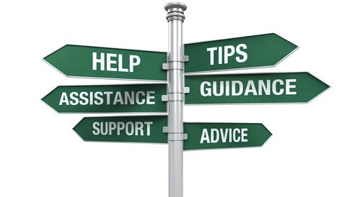
Resources
E-QIP QIP Technical Specifications for OPOC indicators #1, #12, #27 and #30 click here
Notes:
Adv CoP QIP tech specs
42

Slide 43
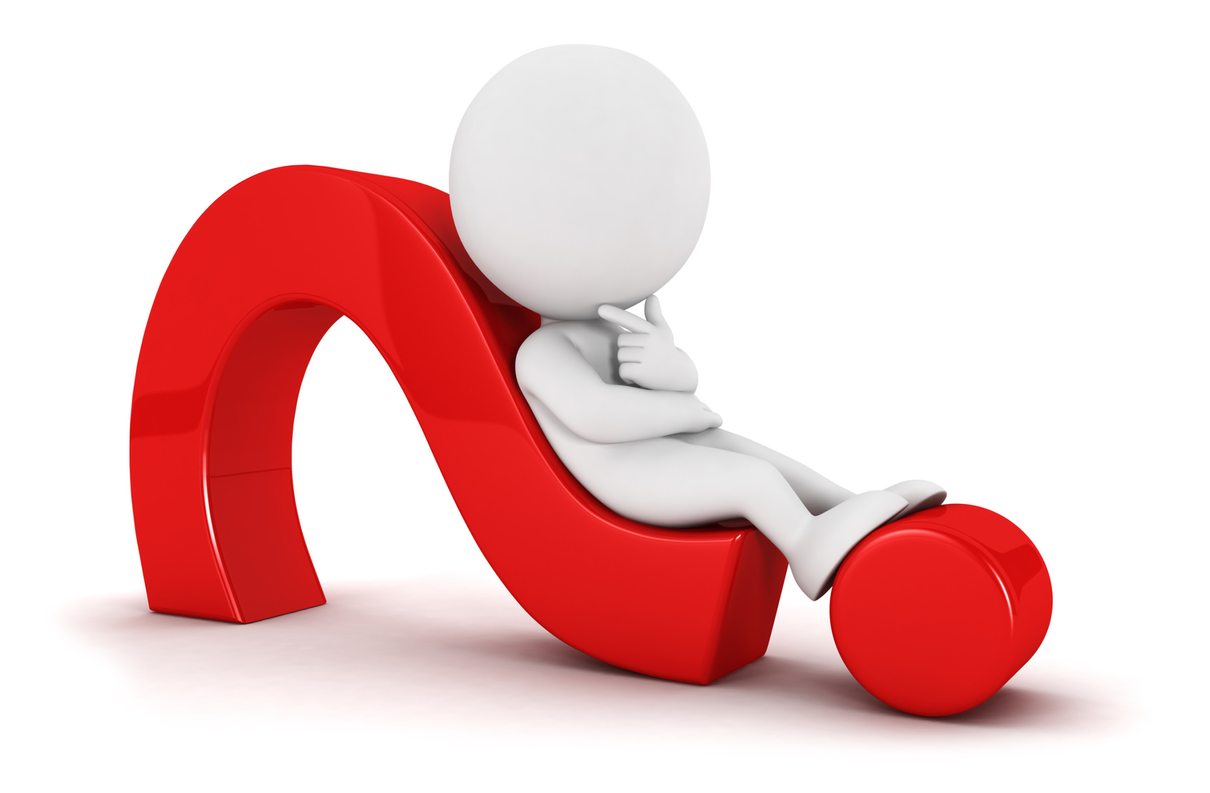
Questions
Notes:
43

Slide 44
Coming Soon!
Chapter 4: Change Ideas -
Now what do we do to actually make all this happen?
Objectives:
• Understand the difference between activity and change ideas
• Understand the PDSA cycle and how to use it to test change ideas
• Understand the relationship between predications and data collection
• Understand how to scope tests of change for rapid learning
• Discuss keys to success
Dec 2, 2020 01:00-2:00 PM in Eastern Time (US and Canada) Registration
Notes:
44

Slide 45

Foundations to QI (IDEAS)
e-Learning Course!
CLICK HERE TO REGISTER!

Slide 46




Visit E-QIP’s Website!
Visit us at www.e-qip.ca
JOIN TODAY!
1) Create and account on Quorum
2) Click on the "Join Group" button on the E-QIP CoP
Don't forget to click the SUBSCRIBE TO UPDATES button in the group to get notified when there's new activity!
Follow us @EQIP_ON
Tag us using #EQIPON
Notes:
46

Slide 47

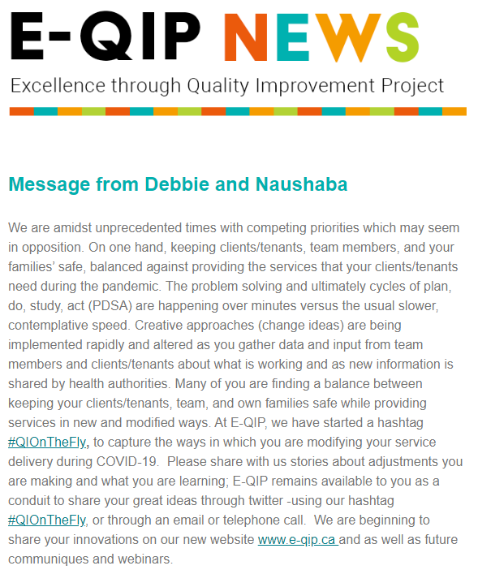
Quick QI Webinars & Newsletter
E-QIP’s Quick QI webinar series now available online!
For refreshing knowledge on the Model for Improvement
A series of 9 webinars which are 20-30 minutes each
Based on our coach’s first-hand experiences and case studies
Join our mailing list to stay informed of future webinars and training events:
http://eepurl.com/b1A5EX
October 31st, 2019

Slide 48
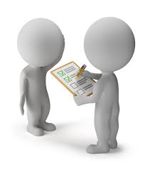
Help us Evaluate our Event!
Please take a few minutes to help us evaluate today’s event and let us know what future topics you would be interested in!
Link to Survey
Notes:
Ash can you update a survey for us
Copy link in the chat box? Who will do this?
48

Slide 49

Notes:
49

