Slide 1


QIOnTheFly Web Meeting #4: Clients as your guide: Experience Based Design
June 17th, 2020
Notes:
Ash
1

Slide 2
Using Zoom Together!
Audio and Visual Controls
Notes:
Ash
2

Slide 3
Using Zoom Together!
During the session if you want to contribute but not speak please use the chat function at the right hand of the toolbar
Notes:
Ash
3

Slide 4

Learning Objectives
Learn about the many ways Experience Based Co-Design (EBD) can help provide a deeper insight into your client/tenants OPOC responses.
Learn more about how to virtually use Experience Based Co-Design (EBD) approaches in an expedited way.
Consider how EBD activities can lead to co-designing the service delivery change with your staff/clients/tenants
Notes:
Ash
Ask Q – In which region of Ontario are you located? Please use the chat box to enter your Ontario Health region (North, East, West, Central or Toronto).

Slide 5
QI On The Fly – How Come?
Unprecedented times with competing priorities
Safety for all balanced against meeting client/tenant needs
Creative approaches (change ideas) are being implemented rapidly and altered as you gather data and input from team members and clients/tenants about what is working
Some change ideas will continue after the pandemic is over as new ways of operating, others, temporary during the COVID-19 experience.
Notes:
Ash
5

Slide 6

Introducing today’s Panelists
            Alice Strachan
              Quality Improvement, Integrated Care
              Ontario Health (Quality)
            Laura Daly-Trottier
              Quality Improvement Coach
              The Excellence through Quality Improvement Project (E-QIP)
Notes:
Ash
6

Slide 7
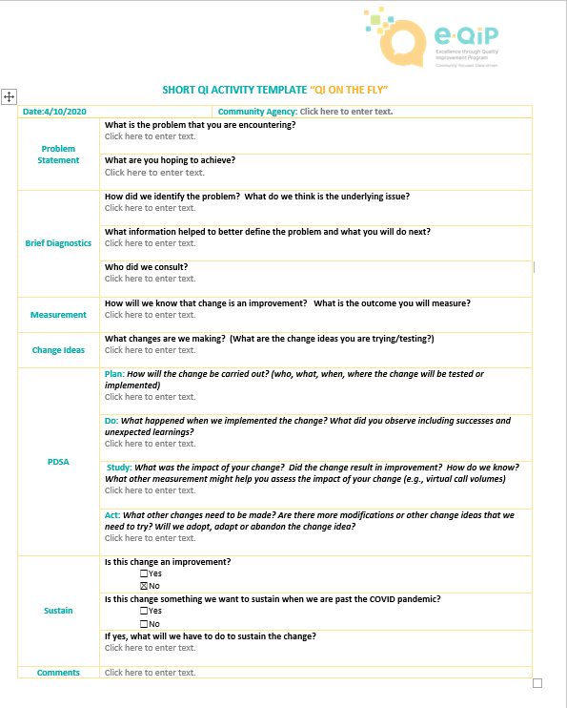
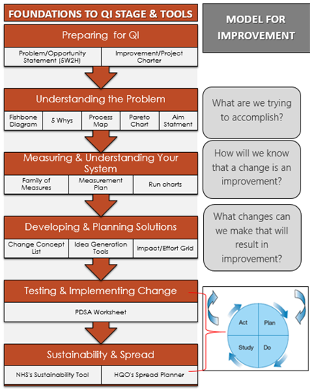
COVID and #QIOnTheFly
Notes:
Ash
On April 22nd, at the first QI-on-the-Fly webinar, we reviewed how to get a better understanding of the problem at hand using virtual technology, including a virtual fishbone
On May 6th, we talked about how you’ll know if the changes you’re making are resulting in an improvement, particularly as it relates to client experience
Today, we will go into more detail about the “how”
7

Slide 8
Recap of webinar #3
Shared thoughts about what you want to know about your client/tenants’ experiences with your service​
Learned how to use the new OPOC scoring tool and how easy it is to input client/tenant responses to a few OPOC questions​
Had an opportunity to consider the “story the data tells”
Shared ideas about how to gather client/tenant responses at your agency and considered the pros and cons of each
Notes:
Deb
8

Slide 9
Experience Based Co-Design (EBD), Quality Improvement (QI) and Ontario Perception of Care (OPOC)
Notes:
Overview of EBD
(use Question #9 from web #4 as the example to frame this section?)
9

Slide 10
3 Ways to Do Quality Improvement
Don’t listen very much to our users, & we do the designing
Listen to our users, then go off to do the designing
Listen to our users, & then go off with them to do the designing
(Professor Paul Bate 2007)
Notes:
Where do you think you are on this continuum?
Can you articulate any examples of the third scenario: Listening to users and then co-designing change with them.
10

Slide 11
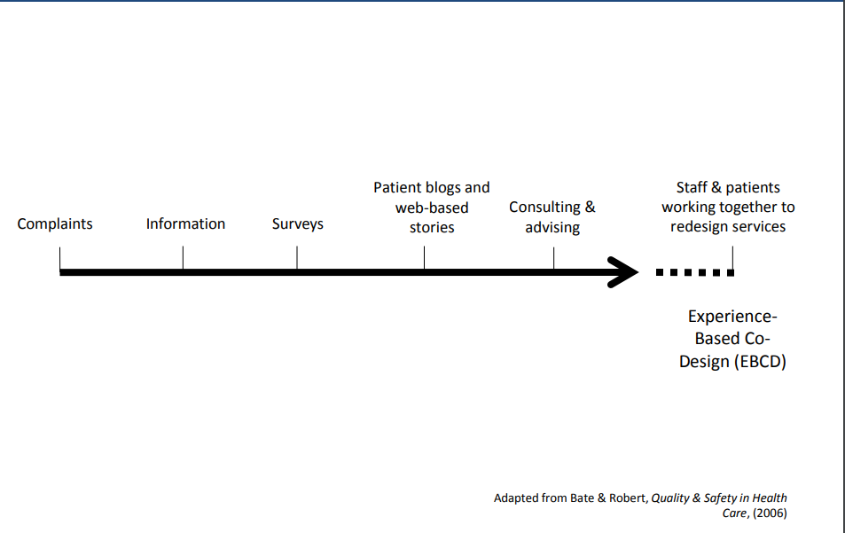
Different ways of giving clients a voice
January 2019
E-QIP EBD Project Discussion Cohort 4
11
Notes:
11

Slide 12

What is Experience Based Co-Design (EBCD)?
12
Notes:
Experience Based Design (EBD) is a structured approach to patient engagement that surfaces the emotions tied to a patient’s experience. EBD brings clients and staff together to share in the role of redesigning and improving health care through a structured improvement approach.
12

Slide 13


Experience Based Design is about designing better experiences…
January 2019
E-QIP EBD Project Discussion Cohort 4
13
Notes:
Experience Based Design approach developed by the NHS Institute for Innovation and Improvement.
Experience-based co-design (EBCD) is an approach that enables staff and clients (or other service users) to co-design services and/or care pathways, together in partnership. The approach is different to other service improvement techniques- and aligns nicely with the MFI
EBD focuses on patient and staff experience and emotions rather than attitudes or opinions.
The approach uses emotions and storytelling to identify opportunities for improvement and focuses on the usability of the service for clients and staff.
It empowers staff and clients to make changes.
Because the approach is qualitative, not quantitative, it provides rich insights into the experience of clients. By collecting the stories of people’s experiences, and then bringing staff and clients together to prioritize areas for improvement and define key actions, it becomes extremely focused and clearly demonstrates results. There is a growing body of evidence showing the effectiveness of the approach
EBD is an adaptable approach.
a focus on designing experiences, not just improving performance or increasing safety
• putting patient experiences at the heart of the service improvement effort – but not forgetting staff
• where staff and patients do the designing together (co-design rather than re-design)
• and, in the process, improving day-to-day experiences of giving and receiving the care, and the way they feel about those experiences
13

Slide 14

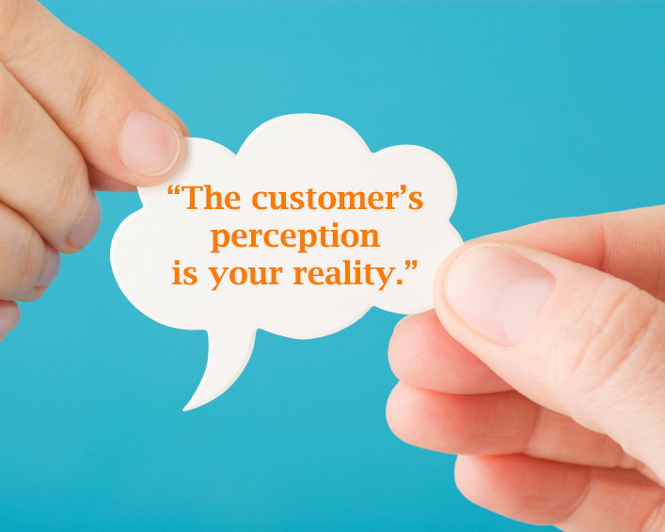
Perception and Experience
OPOC Q #16.
If I had a serious concern, I would know how to make a formal complaint to this organization.
Understanding the experience may lead you to a better understanding of the root cause….
This Photo by Unknown Author is licensed under CC BY-SA-NC

Slide 15

Relying on surveys alone is not enough….
For example, using filters for the OPOC data where there is a smaller number of respondents whose data looks different from others.
In your experience, why is it a good idea to use more than just survey information/data when trying to understand a root cause?
Please share!
January 2019
E-QIP EBD Project Discussion Cohort 4
15
This Photo by Unknown Author is licensed under CC BY-SA
Notes:
Link : use of filters for OPOC – smaller number of respondents, but their particular response look different from others-(data literacy), quality of data collection. Tayla’s example of safety for tenants,
Health equity important to insert.
Barriers to using survey results:
data not specific enough
lack of time and resources
not knowing what to do about the survey results
lack of statistical expertise
‘surveys themselves do not indicate what needs to be done to improve any situation. Further commitment and ingenuity are needed to understand shortcomings in an organization and develop solutions.’ • ‘well designed questionnaires for patients could contribute usefully to an assessment of both the technical competence and interpersonal skills of doctors. If these surveys are to play a role in quality improvement, they should provide clear factual results that prompt follow-up action.’
Sources: Reeves & Seccombe (2007); Davies & Cleary (2005); Coulter (2006)

Slide 16

Relying on surveys alone is not enough….
Value of patients, carers and staff experiences is found:
stories not surveys
‘deep dives’ and direct observation
‘touchpoints’ and emotional mapping
direct participation in the improvement process through co-design: staff and patients
Applying filters to data
Health equity lens
Who’s really responding (who actually completed the survey, what do you know about them?)
January 2019
E-QIP EBD Project Discussion Cohort 4
16
This Photo by Unknown Author is licensed under CC BY

Slide 17
CAPTURE: A Variety of Methods for Capturing the Experience
Breadth
Interviews Shadowing/
Observation Filming/
Photography
Storyboards
Diaries
Emotion questionnaire
Focus groups
Observation
Depth
© NHS Institute for Innovation and Improvement 2006
January 2019
E-QIP EBD Project Discussion Cohort 4
17
Notes:
17

Slide 18

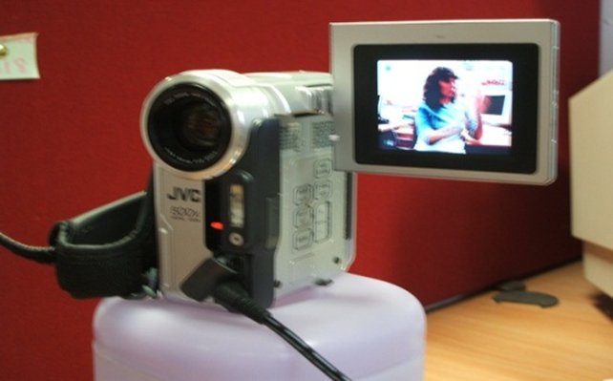

Still Photography and Film is Powerful (Depth)
Top Tips
Open questions – allow story teller to lead the subject
Silence is OK – thinking time
Suspend judgement /don’t make assumptions
Practice active listening
Allow story teller to express emotions without trying to solve problems
Remember that telling the story is a powerful experience
Every picture
tells a story
January 2019
E-QIP EBD Project Discussion Cohort 4
18
Notes:
Remember to
Visualize the journey;
Listen for emotive words;
Understand the underlying triggers for those emotions
18

Slide 19

Observation is….(Breadth and Depth)
About taking a step back
Seeing something for the first time
Understanding what really happens
Inspiration – new ideas
Challenging perceptions
This Photo by Unknown Author is licensed under CC BY-SA
January 2019
E-QIP EBD Project Discussion Cohort 4
19
Notes:
19

Slide 20

Story Boards (Breadth and Depth)
January 2019
E-QIP EBD Project Discussion Cohort 4
20
Notes:
“Challenge yourself to find a way to do this work…”- think more creatively
20

Slide 21
Emotion Questionnaire - Breadth
Asking people to complete an experience questionnaire can be valuable and provides a simple approach to capturing feelings and experience. With some simple adjustments this questionnaire can also be used by staff to identify their experience of delivering the services, for example frustration at having to wait for results.
January 2019
E-QIP EBD Project Discussion Cohort 4
21
Notes:
21

Slide 22
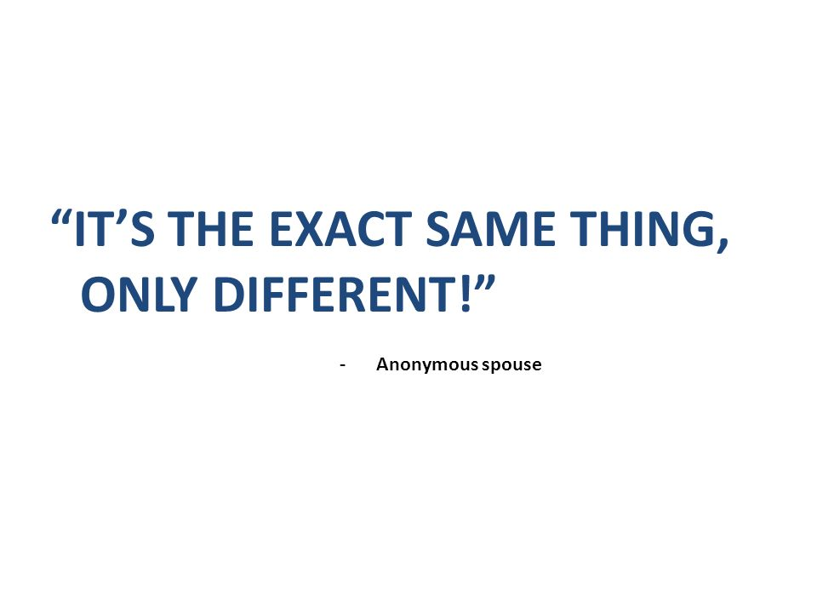
But how do we do this now?
Notes:
The same only different. I love the quote by Henry Ford – if I had asked people what they wanted when I was inventing the car they would have said faster horses. We need to think of new ways that we may not have experienced before to enable our ability to still engage with clients while doing this work
22

Slide 23
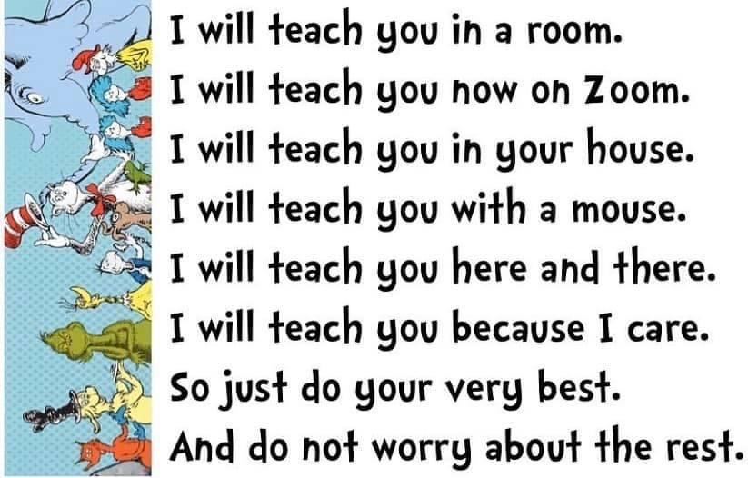
Notes:
So I am going to have you try a Zoom trick today and then we will spend more time on virtual tips and tricks for experience based design on the next webinar on June 23rd – this is a teaser for that webinar. I am using Zoom because that is the platform we are on today, Every virtual meeting tool has some possibilities to be able to engage people and have them feel psychologically safe at the same time(more about that next time)
23

Slide 24
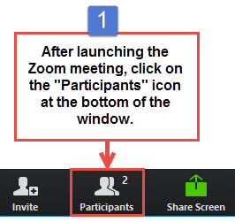
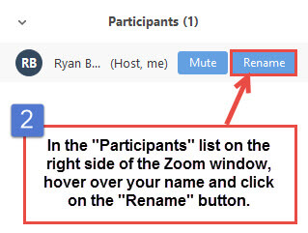
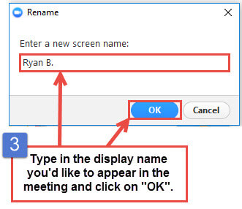
Mickey Mouse
Notes:
So here is what I need you to do – click on participants.
Find your name
Hover over it and it will pop up and give you the option of renaming yourself ( you can also right click on your name in the bottom of the video window that shows you
Today I want you all to have the same name and that name is Anonymous – so type Anonymous into that Screen Name baox and then click ok

Slide 25


So I could ask, choose which photo best represents how you are feeling today
A
B
Type your response in the the Chat Box but DO NOT press Enter yet!
Notes:
I give them a few seconds and then have them hit enter. So two things happened here. We gave people the ability to share their responses anonymously ( and you could still get data from that – Zoom saves the chat box entries along with the recording) The waiting to hit enter is so that people are not influenced by what others are saying – so if I wait and watch others submit their selection and I see everyone is pressing B perhaps that will intimidate me to also say B even though I know we are all Mickey Mouse

Slide 26
QIOnTheFly Web Meeting #5
Clients as your Guide:
EBD – the How-to Sequel
Tuesday, June 23, 2020
1:00-2:00pm CLICK HERE TO REGISTER!
Objectives:
  Learn more about how Experience-based co-design (EBD) can further inform your QI on the fly work.
  Experience a virtual EBD activity to gain insight into a common OPOC response.
  Share/receive practical tips on conducting EBD activities virtually.
Notes:
Ash
Insert teaser for June 23….
Insert teaser for Process Mapping – choose a date and insert here…Alice will draft objectives and send around to us- Alice will pick a couple of dates (Week of July 15th/August 17th)
26

Slide 27

Questions
Notes:
Deanna
27

Slide 28

Resources
EBD resources
QI on the Fly template
https://improvement.nhs.uk/documents/1486/ebd_guide___toolkit.pdf
Notes:
Deanna
These resources will be emailed to you after the webinar
Tracking template updated with run chart tab
28

Slide 29




Visit E-QIP’s New Website!
Visit us at www.e-qip.ca
JOIN TODAY!
1) Create and account on Quorum
2) Click on the "Join Group" button on the E-QIP CoP
Don't forget to click the SUBSCRIBE TO UPDATES button in the group to get notified when there's new activity!
Follow us @EQIP_ON
Tag us using #EQIPON
Notes:
Ash
29

Slide 30

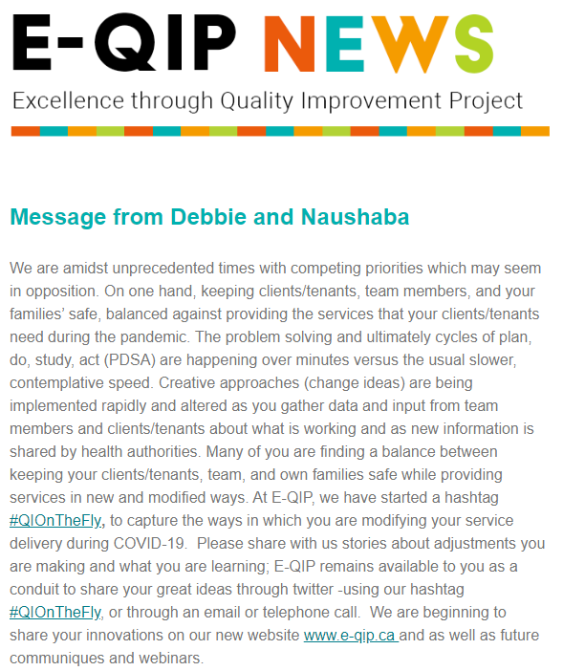
Quick QI Webinars & Newsletter
E-QIP’s Quick QI webinar series now available online!
For refreshing knowledge on the Model for Improvement
A series of 9 webinars which are 20-30 minutes each
Based on our coach’s first-hand experiences and case studies
Join our mailing list to stay informed of future webinars and training events:
http://eepurl.com/b1A5EX
October 31st, 2019
Notes:
Ash

Slide 31

Help us Evaluate our Event!
Please take a few minutes to help us evaluate today’s event and let us know what future topics you would be interested in!
Link to Survey
Notes:
Ash
Ash will update the survey for us
Copy link in the chat box? Who will do this?
31

Slide 32

Notes:
Ash
32

