Slide 1
Interpreting Run Charts

Slide 2
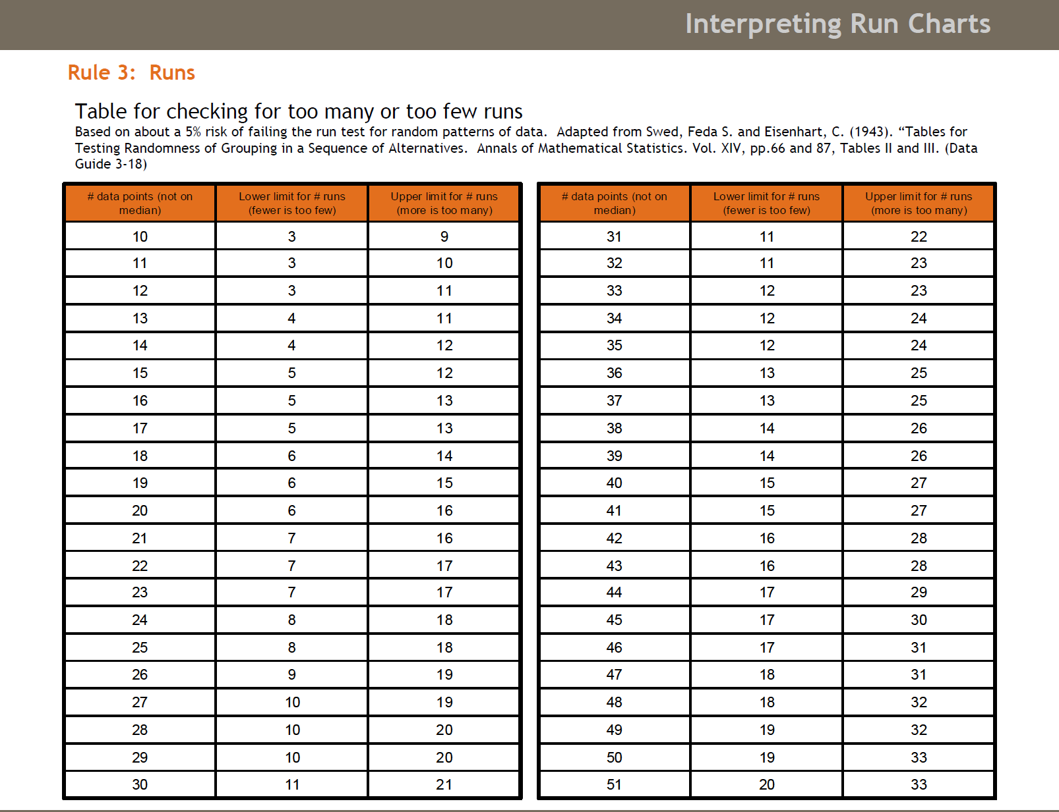
Step 1: Count the number of data points on the run chart, not
including those on the median (Column 1)
Step 2: Count the number of runs (ie the number of times the line crosses the median and add 1
Step 3: If the number from Step 2 is less than the number in Column 2, it is a signal too few runs,
or if it is greater than the number in Column 3, it is a signal (too many runs)

